Slide 1



Slide 2


高三年级英语学科
阅读表达
授课教师：刘璐霏 学校：北京交通大学附属中学
指导教师：孙铁玲 学校：海淀区教师进修学校

Slide 3

Acknowlegements
孙铁玲，李晓芸老师的全程悉心指导，
刘景军老师带领下阅表出题组的同心协力智慧引领,
阅表定标组的辛勤付出！
阅表出题组
李美萱 一零一中学
王磊 中关村中学
（按姓氏拼音顺序）
阅表定标组
董芷卉 北大附中
范宇亮 人大附中
李佳亮 清华附中
马婷 人大附中航天城校区
（按姓氏拼音顺序）

Slide 4

1
第一部分 试题解读
目 录
2
第二部分 评分标准
CONTENTS
3
第三部分 讲评建议
4
第四部分 教学建议

Slide 5
01
试题解读

Slide 6
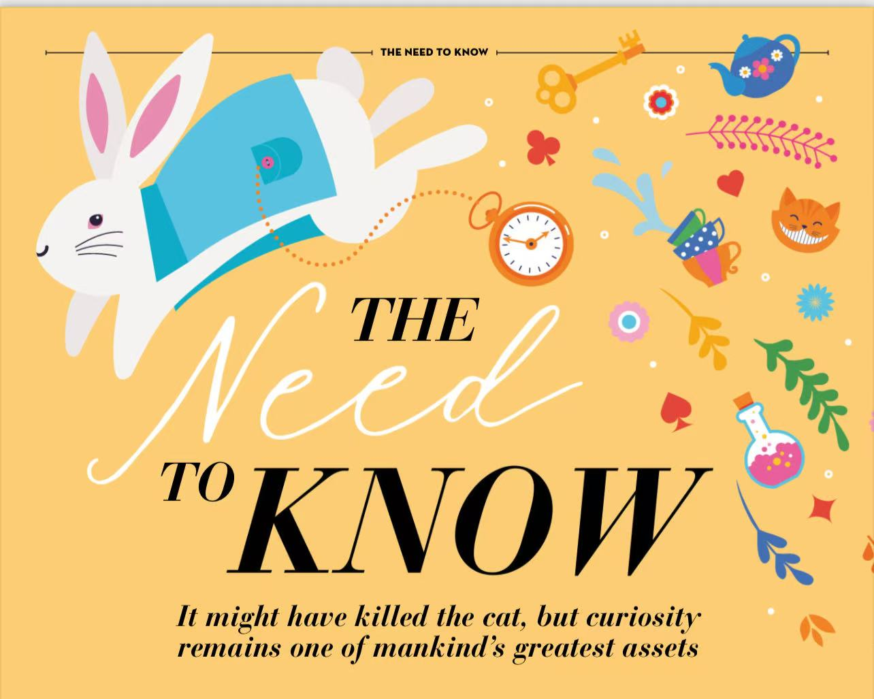
文章类型 | 说明文（362words）
文本大意 | 文章阐述了好奇心的定义及三种类型。儿童时期，好奇心强烈，但长大后好奇心逐渐消退，神经科学解释这是因为大脑灵活性降低，依赖早期通路以节省脑能量。但研究表明我们应继续培养好奇心，能降低焦虑、提升生活满意度、助力学业成就、增进共情与人际关系，还能保护大脑健康。好奇心曾推动人类从石器时代走向信息时代，对个人而言能带来满足感，对人类生存与发展都至关重要。
文章主旨 | 强调好奇心的重要性和培养好奇心的必要性。
主题语境 | 人与自我（个人成长）

Slide 7

The Cambridge Dictionary defines curiosity as “an eager wish to know or learn about something” which comes in various types. Ian Leslie, in his book Curious, outlines three types: ‘‘adventurous curiosity”, the desire to explore new places and people; “intellectual curiosity”, the deep dive you take when finding out about a particular topic; and “empathetic curiosity”, the wanting to find out more about the people around us. As children, we bubble over with curiosity. However, as we grow up, it can fade. Worse, we can come to believe that it’s a bad thing. After all, didn’t it kill the cat?
Neuroscience suggests one explanation for this decline. Brains in early childhood possess great plasticity and lay down lots of neural pathways based on the information we gather from all that curious exploring and experimenting. However, as we grow older, our brains lose some of that flexibility. And we rely on those earlier pathways to deal with the things we’ve seen and done before. It’s a way of conserving brain energy for economy and competence in coping with ordinary life.
Whatever underlies our shrinking curiosity, research repeatedly shows that we’d be better off continuing to cultivate it. Curiosity is linked to lower levels of anxiety, a greater satisfaction in life, achieving academically, building empathy and improved relationships. It also protects brain health through staying mentally active by trying something new. These positive effects of curiosity are deeply intertwined with our brain’s chemical responses. Research shows that brain’s dopamine system is activated by when something novel happens. Rather than produce pleasure, dopamine actually stimulates our longing to continue the activity, in this case the desire to find out more. It’s easy to see how this brain chemistry has helped us.
Curiosity has motivated our ancestors to question, experiment and learn, leading us out of the Stone Age to the Bronze Age and the Iron Age and, finally, to the Information Age. It has sparked our greatest achievements and discoveries and continues in our personal lives to bring greater contentment. So, perhaps the cat was simply unlucky, because for us humans, curiosity continues to be essential, both to our survival and our ability to flourish.
Para.1: Definition &
classification
Para.2:
Explanation for its decline.
Para. 3: Benefits and Dopamine’s role
Para. 4: Impacts

Slide 8
命题原则
由浅入深，按照文章行文逻辑进行设问，引导学生完成对整个语篇的理解。在最后一个问题中，引导学生能够基于语篇并联系自身实际，有效地用英语输出。
40. What are the three types of curiosity according to Ian Leslie?
41. Why do we rely on earlier pathways to deal with the things we’ve seen and done before?
42. Please decide which part is false in the following statement, then underline it and explain why.
➢When something novel happens, the dopamine system of the brain is activated to make us feel happy.
43. How do you develop your curiosity? (In about 40 words)
事实细节-了解分类
总结归纳-知其原因
分析判断-革新认知
创新迁移-个人发展

Slide 9
02
评分标准

Slide 10
40题，41题
1.5
1
0.5
0
2

Slide 11
40，41题语言错误扣分统一说明：
时态、关键单词拼写错误、名词单复数等（1处）扣0.5分
语言错误可叠加，最多扣1分。

Slide 12
阅读表达40题参考答案

Slide 13
40. What are the three types of curiosity according to Ian Leslie? (2分)
Adventurous curiosity,intellectual curiosity,and empathetic curiosity.
(Para.1)The Cambridge Dictionary defines curiosity as “an eager wish to know or learn about something” which comes in various types. Ian Leslie, in his book Curious, outlines three types: ‘‘adventurous curiosity”, the desire to explore new places and people; “intellectual curiosity”, the deep dive you take when finding out about a particular topic; and “empathetic curiosity”, the wanting to find out more about the people around us.

Slide 14
40. What are the three types of curiosity according to Ian Leslie? (2分)
Adventurous curiosity,intellectual curiosity,and empathetic curiosity.
几点说明：
1. 添加相关冗余， 不扣分
2. 大小写，不扣分。
3. 标点符号，不扣分。

Slide 15
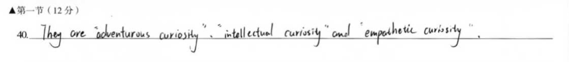
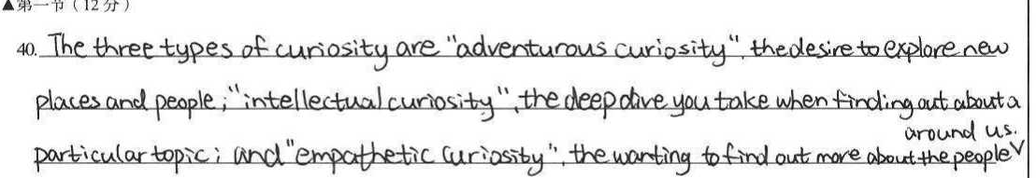
标答外其他可以接受的答案 + 2

Slide 16
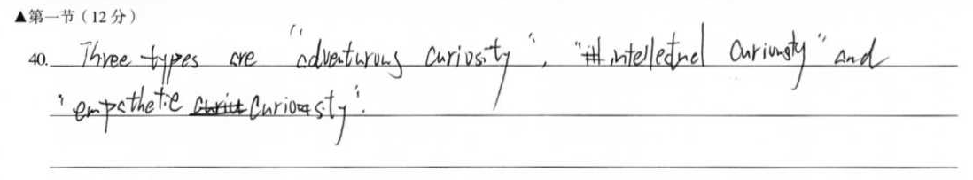
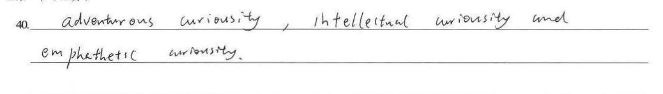
语言：关键信息拼写错误 +1.5分
curiosity 重复拼错，算一处

Slide 17
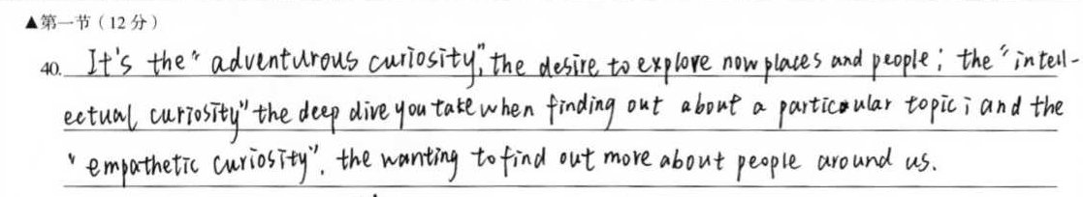
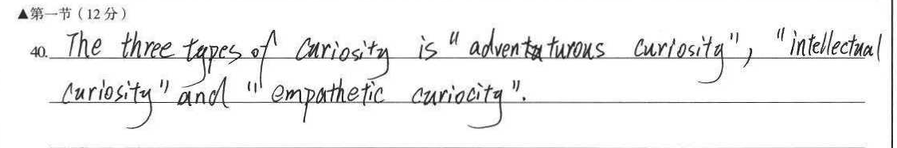
语言：谓语动词错误 +1.5分

Slide 18
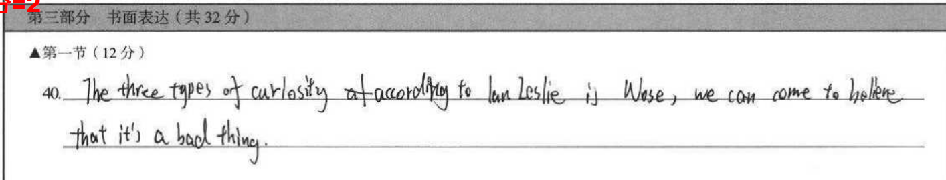
内容：无关信息 0分

Slide 19
阅读表达41题参考答案

Slide 20
41. Why do we rely on earlier pathways to deal with the things we’ve seen and done before?
Because as we grow older, our brains lose some of the flexibility./
Because it’s a way of conserving brain energy for economy and competence in coping with ordinary life.
(Para.2)Neuroscience suggests one explanation for this decline. Brains in early childhood possess great plasticity and lay down lots of neural pathways based on the information we gather from all that curious exploring and experimenting. However, as we grow older, our brains lose some of that flexibility. And we rely on those earlier pathways to deal with the things we’ve seen and done before. It’s a way of conserving brain energy for economy and competence in coping with ordinary life.

Slide 21
41. Why do we rely on earlier pathways to deal with the things we’ve seen and done before?
Because as we grow older, our brains lose some of the flexibility./
Because it’s a way of conserving brain energy for economy and competence in coping with ordinary life.
几点说明：
1.flexibility+ conserving，2分。
2.没有because, 不扣分。
3.lose some of that flexibility,不扣分。

Slide 22
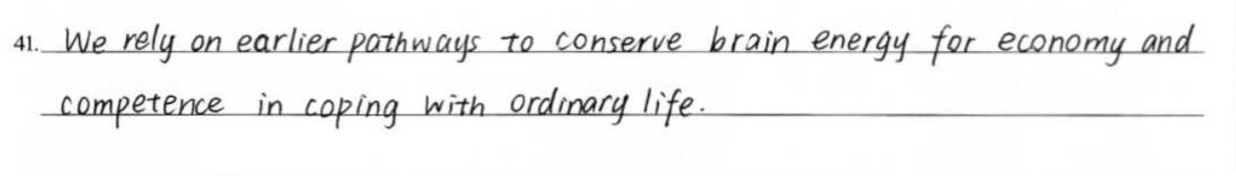
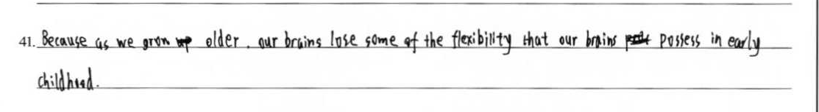
标答外其他可以接受的答案 +2
加工原文信息，表达正确。

Slide 23
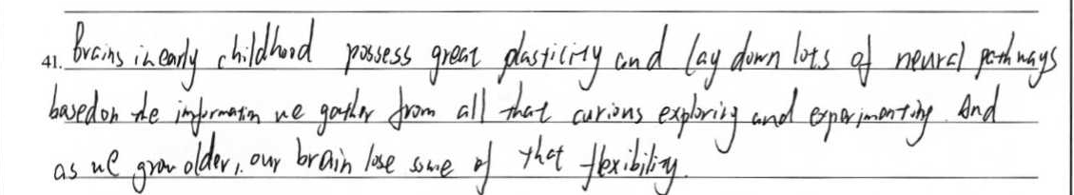
标答外其他可以接受的答案 +2
相关细节，不扣分。

Slide 24
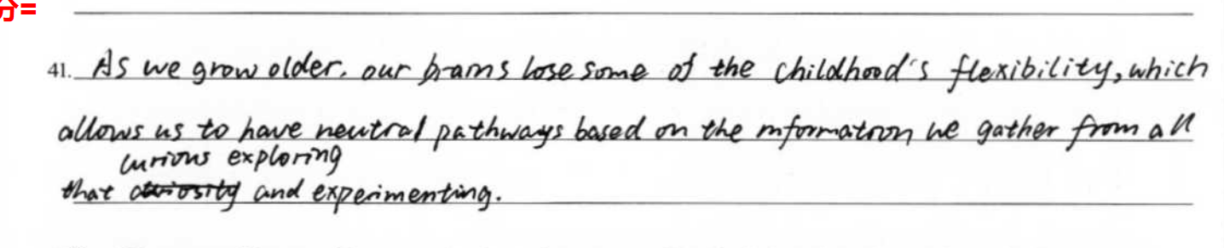
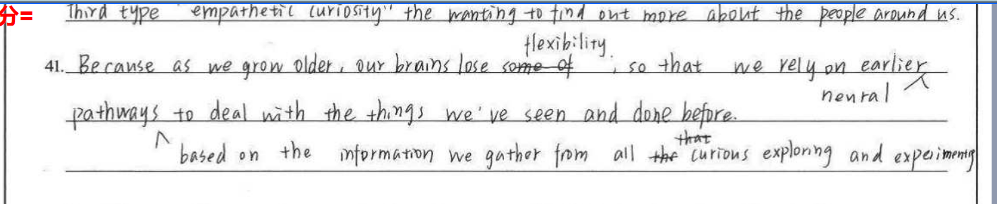
拼写错误，句式错误 +1.5

Slide 25
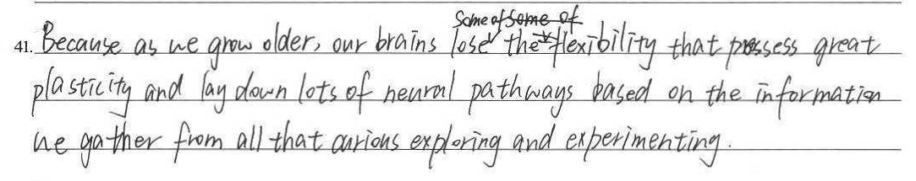
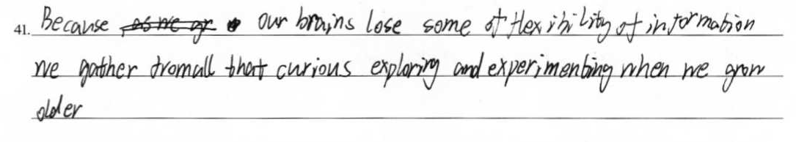
解释flexibility时，出现严重表意错误 +1 分

Slide 26
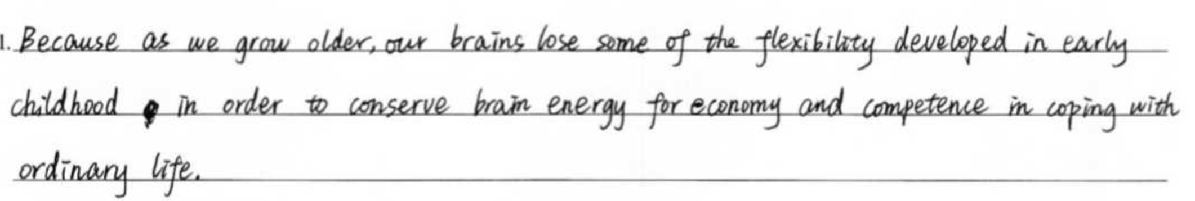
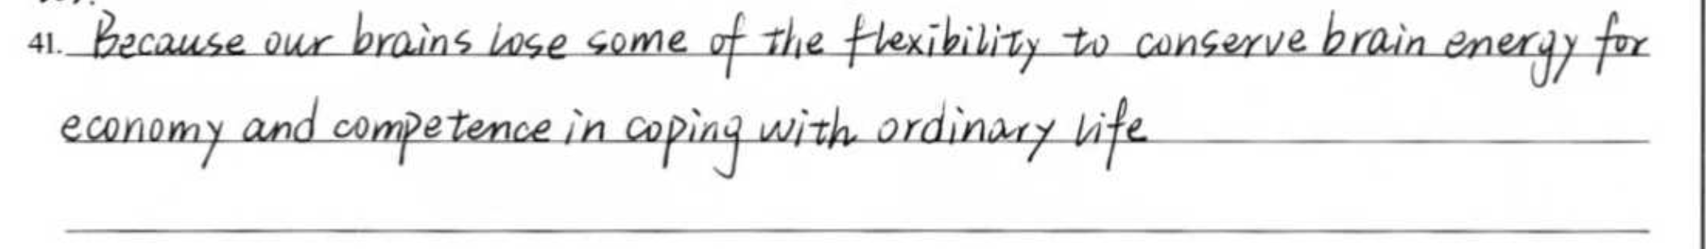
Flexibility+conserving信息整合时，出现严重表意错误 +1分

Slide 27
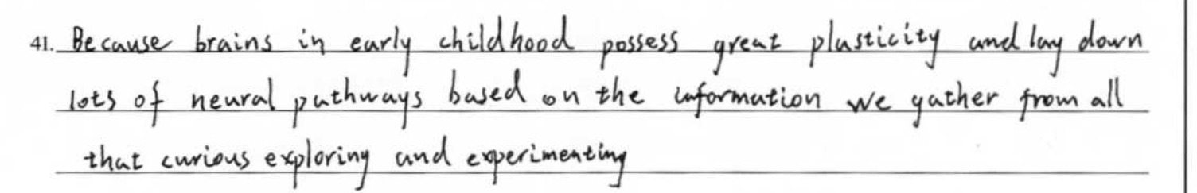
内容：无关信息 0 分

Slide 28
阅读表达42题参考答案

Slide 29
42题，划线部分分数设置
0
1
Notes:
评分步长

Slide 30
42题：解释部分分数设置
0
0.5
1
1.5
2
【特别提示】划线1分；解释2分；单独给分，无需匹配。

Slide 31
42.Please decide which part is false in the following statement, then underline it and explain why.
When something novel happens, the dopamine system of the brain is activated to make us feel happy.
(Para.3)...These positive effects of curiosity are deeply intertwined with our brain’s chemical responses. Research shows that brain’s dopamine system is activated when something novel happens. Rather than produce pleasure, dopamine actually stimulates our longing to continue the activity, in this case the desire to find out more. It’s easy to see how this brain chemistry has helped us.
Something novel happens
Dopamine system is activated
Dopamine stimulates our longing
Dopamine makes us feel happy

Slide 32
42.Please decide which part is false in the following statement, then underline it and explain why.
➢When something novel happens, the dopamine system of the brain is activated to make us feel happy.
(Para.2)...These positive effects of curiosity are deeply intertwined with our brain’s chemical responses. Research shows that brain’s dopamine system is activated when something novel happens. Rather than produce pleasure, dopamine actually stimulates our longing to continue the activity, in this case the desire to find out more. It’s easy to see how this brain chemistry has helped us.
When something novel happens, the dopamine system of the brain is activated to make us feel happy.
When something novel happens, the dopamine systems of the brain is activated to stimulate our longing to continue the activity /our desire to find out more.

Slide 33
其他正确的划线方法，得+1分

Slide 34
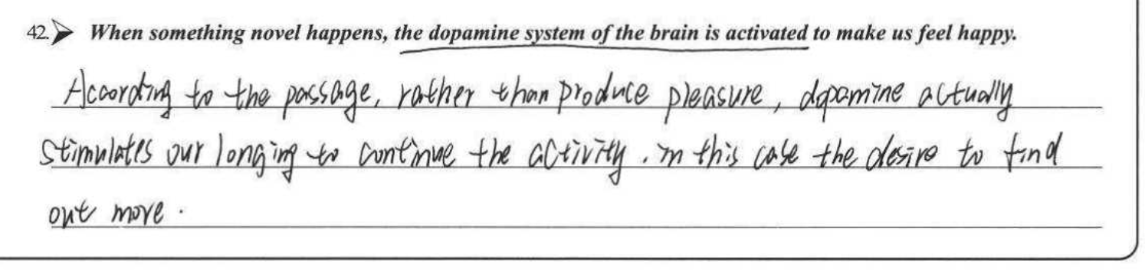
解释部分满分+2

Slide 35
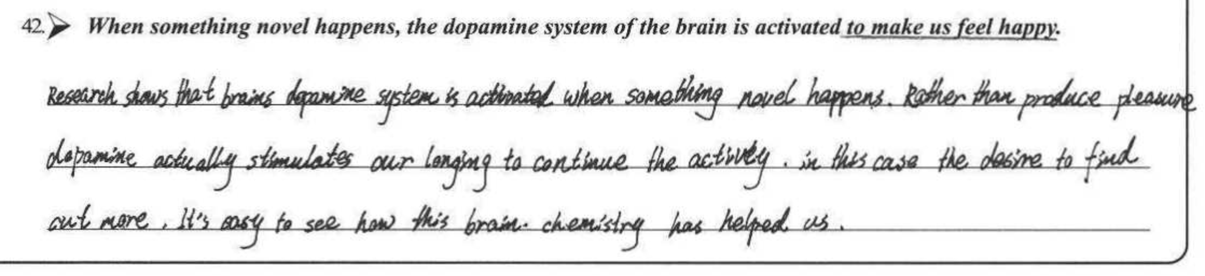
解释部分无关冗余+1.5

Slide 36
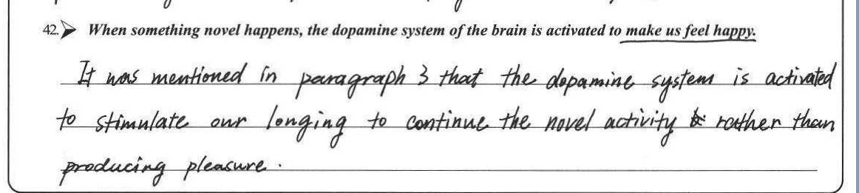
解释部分语法错误 +1

Slide 37
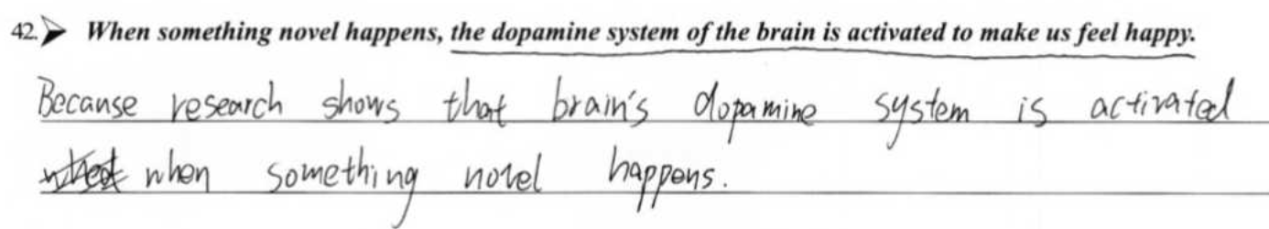
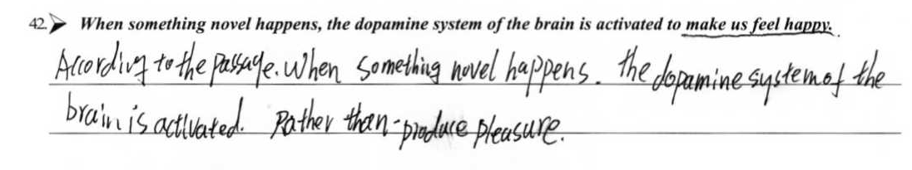
解释部分答非所问 0分

Slide 38
阅读表达43题评分标准

Slide 39
原则：先按照内容定档，再根据语言扣分，有0.5分档。
1.5
2.5
3
0.5
0
2
3.5
4
4.5
5

Slide 40
分数档 |  | 具体描述
一档 | 5分 | 紧扣主题。语言准确、连贯，有个别错误，逻辑清晰。
二档 | 3-4分 | 贴近主题。在准确性和连贯性上有少量错误，不影响理解。
三档 | 1-2分 | 和主题相关。语言上有大量错误，影响理解。
四档 | 0分 | 所写内容和主题完全不相关，或只孤立地罗列与主题相关的个别单词。
Notes:
1+4

Slide 41
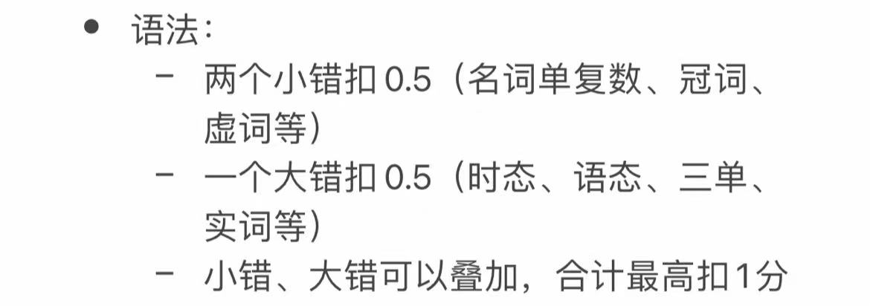
具体解读 – 内容先行
内容：内容意义上言之有理，自圆其说，即可得分。 照抄原文某些段落，不得分。 所表达内容与题目要求无关，不得分。
语言：准确、连贯；如有错误，酌情扣分。
5分也容语言错误，但必须是一个小错。
3. 字数要求
超过4.5行扣0.5。

Slide 42
43. How do you develop your curiosity ？
冒险型好奇心（Adventurous Curiosity)
探索新地方：去不同的城市或国家旅行，体验不同的文化和风俗。
结识新朋友：主动与不同背景的人交流，了解他们的生活方式和观点。
知识型好奇心: (Intellectual Curiosity)
深入研究特定主题：选择一个你感兴趣的领域，如科学、艺术或历史，进行深入学习。
阅读和学习：阅读书籍、观看纪录片、参加讲座，不断拓宽知识面。
同理心型好奇心（Empathetic Curiosity）：
倾听他人：与身边的人进行深入的对话，了解他们的感受和经历。
参与社区活动：加入志愿者组织，帮助他人，更好地理解他们的需求和挑战。

Slide 43
其他角度
Seek novel things:
We can look for experiences that are moderately new to us. For instance, if you usually read mystery novels, pick up a science fiction book from an author you've never heard of. It's not so unfamiliar that it becomes overwhelming, but different enough to spark new thoughts and questions. This helps maintain an ideal level of information absorption and keeps our minds engaged.
Embrace the unexpected in play or hobbies:
Similar to how children prefer toys that violate their expectations, we can introduce an element of surprise into our hobbies. If you're into painting, try using unconventional materials like coffee or salt to create textures. When something doesn't go as planned in a leisure activity, instead of getting frustrated, take it as an opportunity to explore and learn why it happened, which may lead to new discoveries.
Question causal relationships:
Following children's behavior of deconfounding causal variables, we can be more inquisitive about the causal links in our daily life. When your phone battery drains quickly, don't just accept it and charge it right away. Wonder why it happened – was it a new app you installed, a change in settings, or a problem with the battery itself? By trying to isolate the cause, we dig deeper into how things work around us.
Break routine patterns:
Given that novelty can trigger curiosity, making small changes to our daily routines can be beneficial. Take a different route to work, try a new coffee shop, or rearrange the furniture in your room. These minor alterations expose us to new sights, sounds, and sensations, which may prompt us to ask questions and seek more knowledge.
Source: Kidd, C. , & Hayden, B. . (2015). The psychology and neuroscience of curiosity. Neuron, 88(3), 449-460

Slide 44
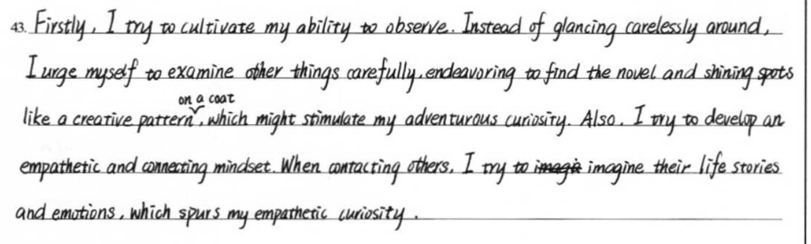
紧扣主题，逻辑清晰，分类讨论，语言流畅，准确性高
5分
develop my curiosity
observing and examing
adventurous curiosity
connecting mindset and imagining
empathetic curiosity

Slide 45
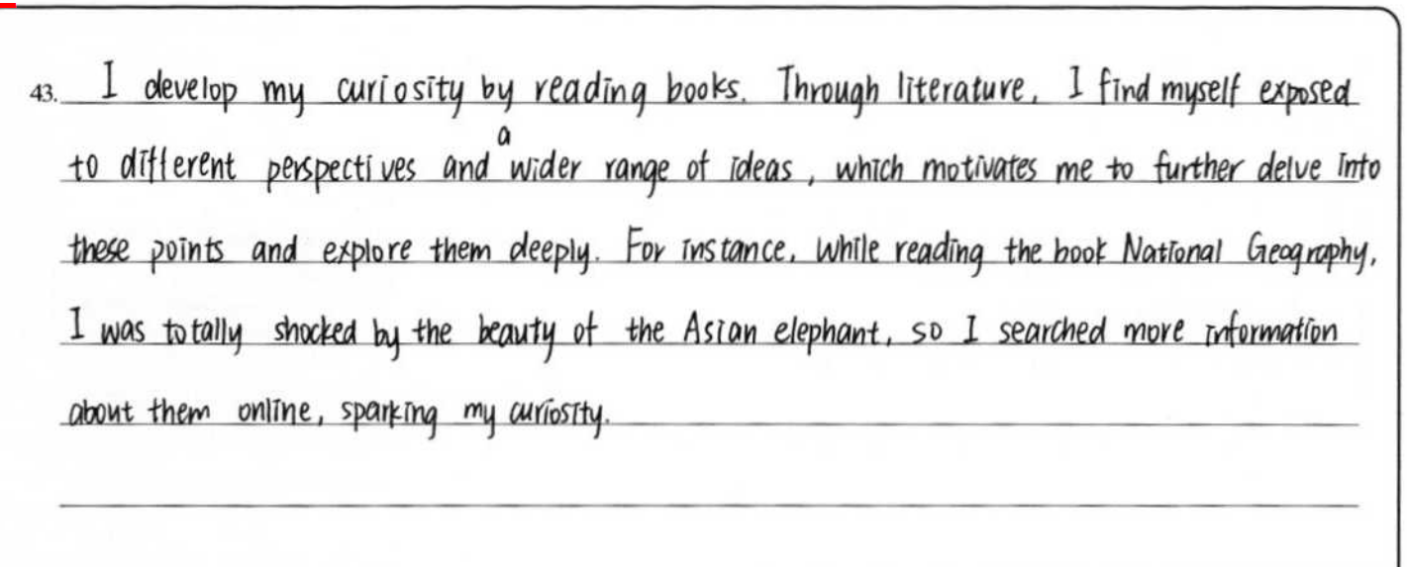
5分
紧扣主题，内容充实，例证合理，逻辑清晰，语言准确性高
my own example
reading books
develop my curiostiy

Slide 46
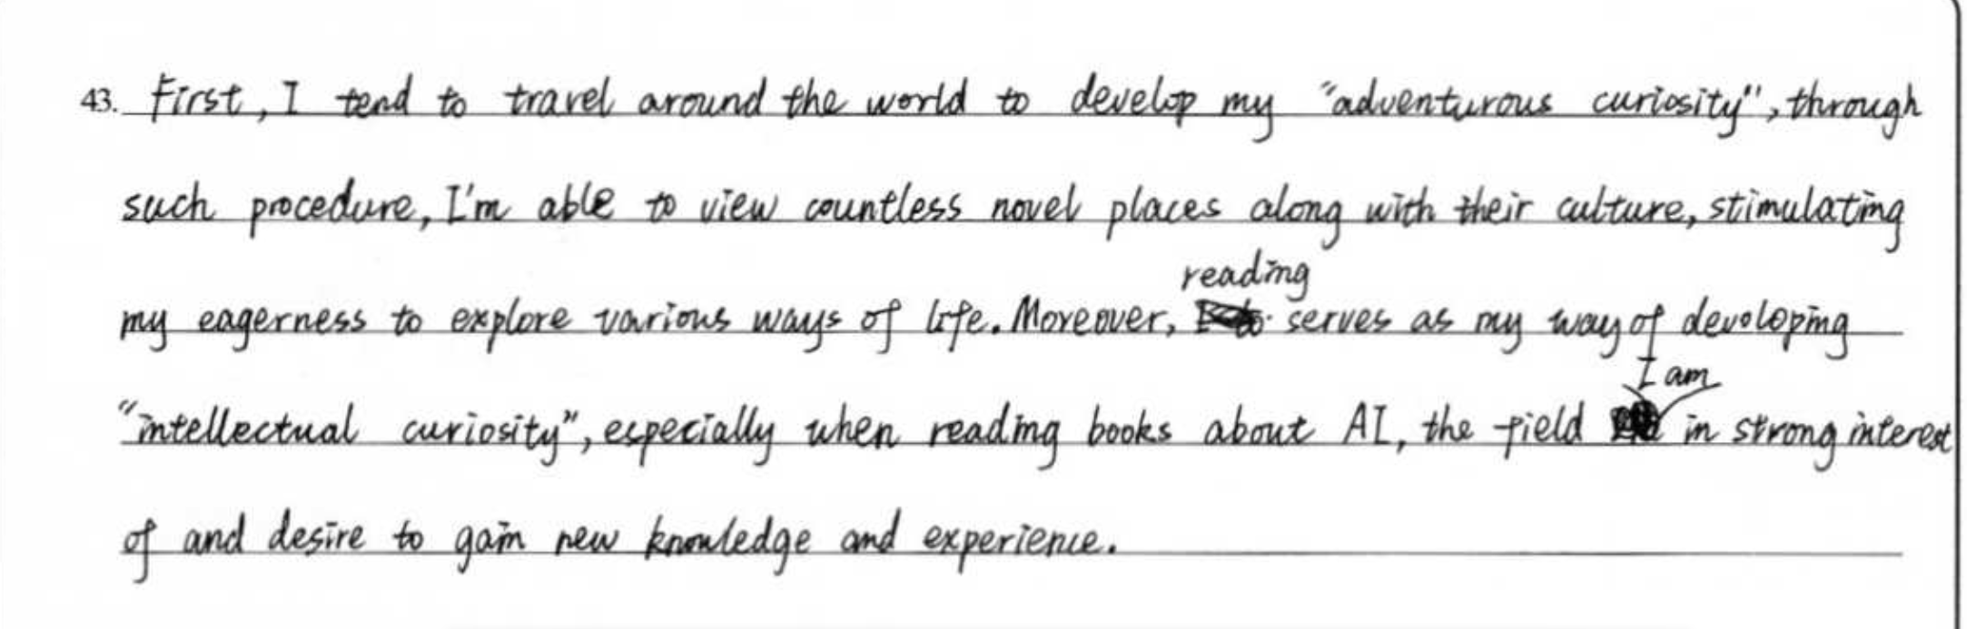
紧扣主题，内容充实，逻辑清晰，表达连贯，有个别小错
4.5分

Slide 47
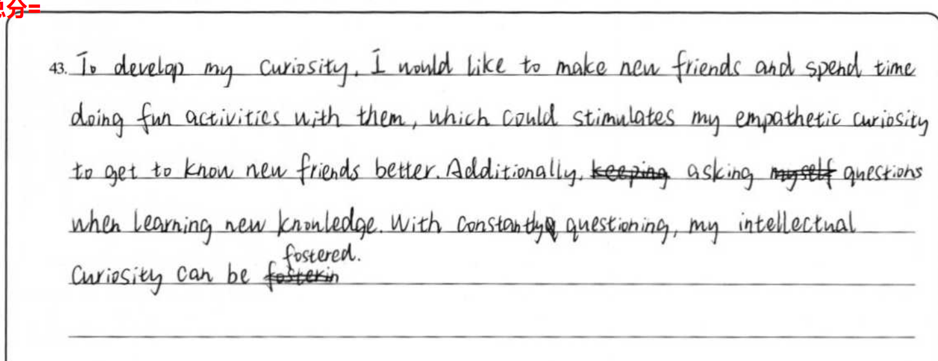
4分
紧扣主题，内容充实，逻辑连贯，累加语言错误。

Slide 48
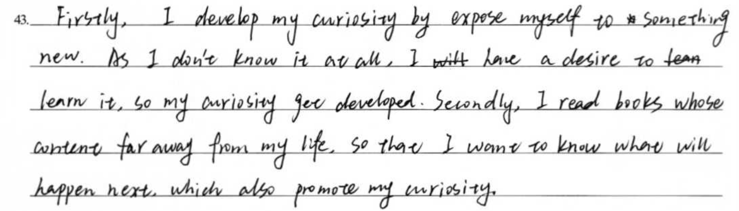
内容较充实，语言表达流畅，但个别地方，说理不够充分，语言错误。
3.5分

Slide 49
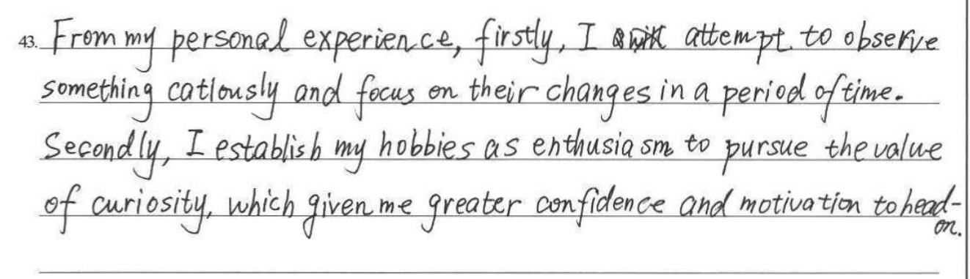
3分
内容较充实，语言表达流畅，逻辑解释不够充分

Slide 50
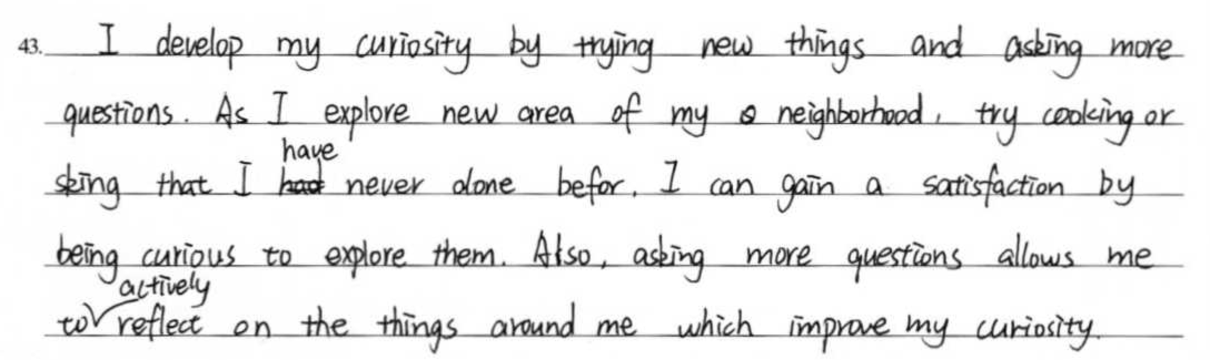
基本完成写作任务，但要点一内部逻辑跳跃，偏题，解释牵强。
2.5分

Slide 51
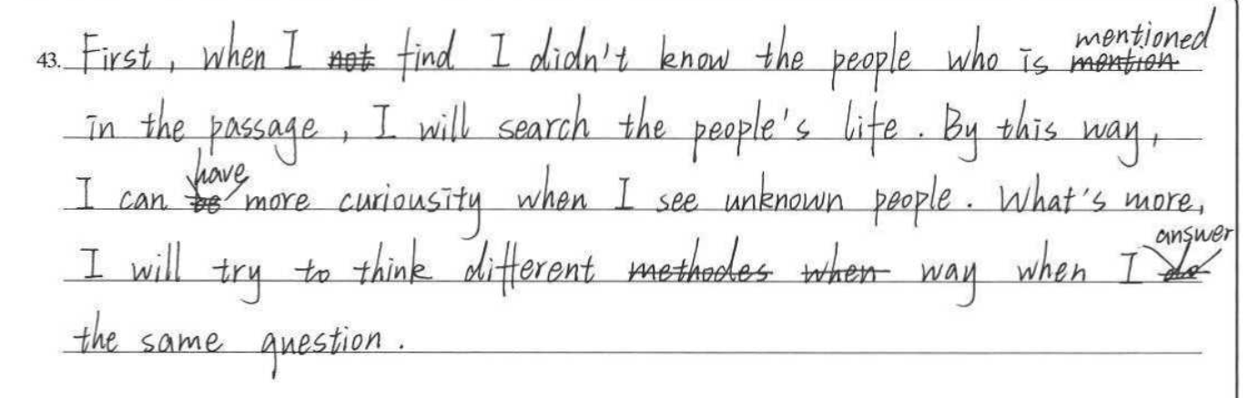
立意浅，思维含量不够，语言不准确，逻辑不连贯
2分

Slide 52
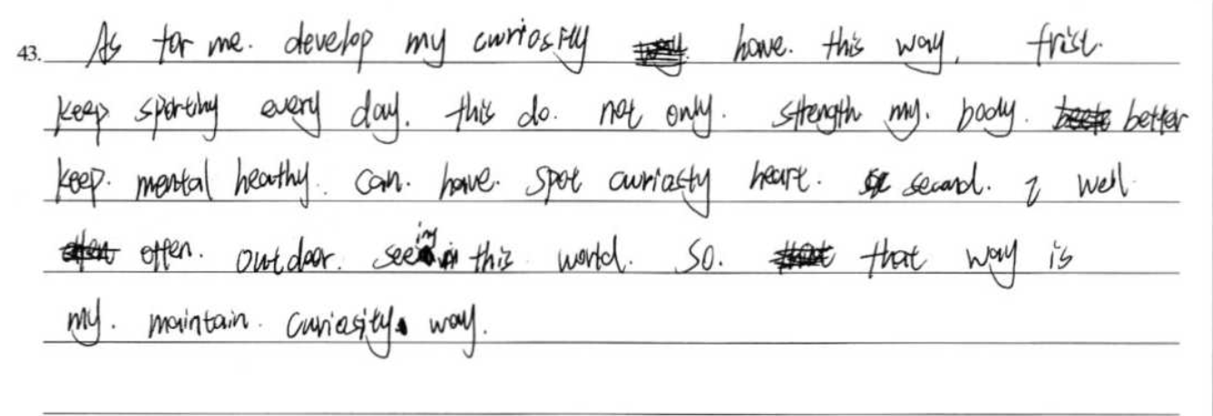
0.5分
第一点跑题，通过运动来发展好奇心，强行关联主题

Slide 53
03
讲评建议

Slide 54
Revising
How does observing closely help develop my curiosity?
From my personal experience, firstly, I attempt to observe something carefully and focus on their changes over a period of time. This practice helps me develop a keen sense of observation, which is crucial for nurturing curiosity.

Slide 55
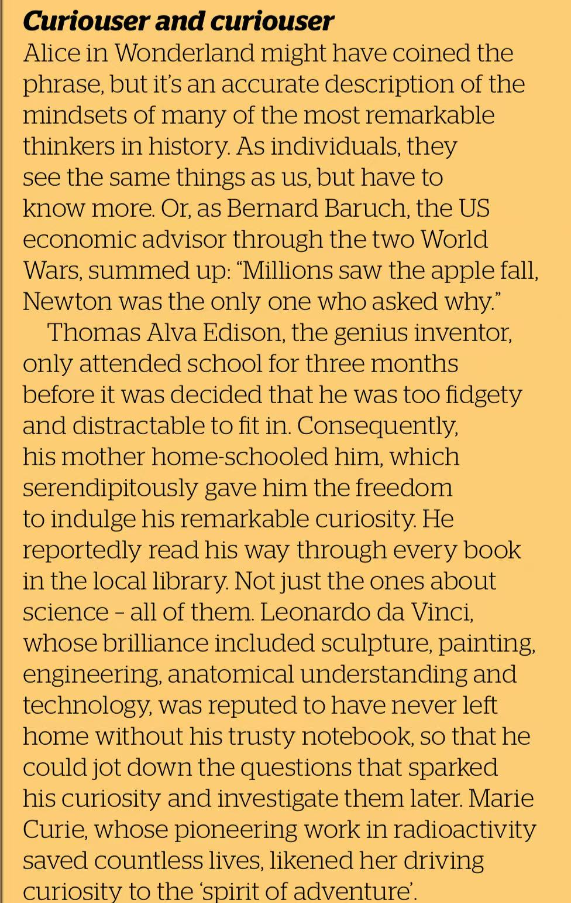
Choose another figure and discuss how their curiosity influenced their achievements.
Different approaches to the text
Qian Xuesen, a foundational figure in Chinese aerospace, was driven by an innate curiosity that inspired him to pursue advanced studies. His inquisitive nature led him to explore the complexity of rocket science and aerodynamics. This relentless curiosity played a significant role in shaping China's space program, propelling its scientific and technological advancement.

Slide 56
How does curiosity benefit you in your life?
Different approaches to the text
Leonardo Da Vinci was a genius: wildly imaginative, passionately curious and creative across multiple disciplines—painting, architecture, aeronautics, and engineering. Part of what made Leonardo a genius, what set him apart from people who are merely extraordinarily smart, was creativity. His talent for combining observation with fantasy allowed him to make unexpected leaps that related things seen to things unseen.
...
Seek knowledge for its own sake. Not all knowledge needs to be useful. Sometimes it should be pursued for pure pleasure. Leonardo did not need to know how heart valves work to paint the Mona Lisa, nor did he need to figure out how fossils got to the top of mountains to produce Virgin of the Rocks. By allowing himself to be driven by pure curiosity, he got to explore more horizons and see more connections.
Keep a childlike sense of wonder. At a certain point in life, most of us quit puzzling over everyday phenomena. We might savor the beauty of a blue sky, but we no longer bother to wonder why it is that color. Leonardo did.
Be curious, observe things, see things unseen, respect facts, be open to mystery… We can never learn enough from Leonardo.
Curiosity serves as a catalyst for my personal growth, sparking an eagerness to learn and acquire new knowledge, which in turn leads to self-improvement. Furthermore, it enriches my life by encouraging me to wonder at the ordinary phenomena around me, discovering beauty and joy in the everyday aspects of daily living.

Slide 57
04
复习建议：
向内深挖共鸣与共情
向外彰显观点与格局

Slide 58
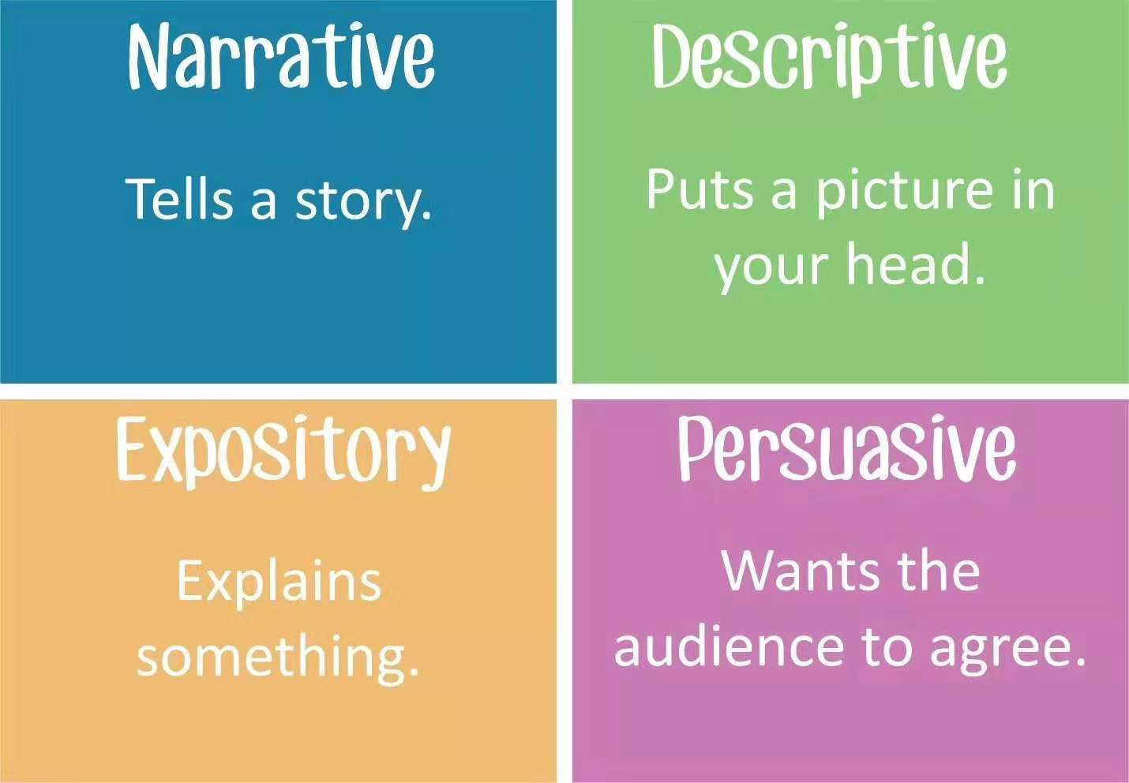
Text genre and purposes

Slide 59
Raising awareness of writing purposes
Purposes of writing
To inform
例证类
行动方案类
To comment or give an opinion
观点评价类
分析讨论类

Slide 60
例证类：
To inform
此类题目的共性是，给出一个新的概念、方法或者是理论，让我们举出文本之外的例子。解决此类题目的关键是，要找出这个概念、方法或者理论的特点，并在写例子的过程中表现出这种特点，使之与概念、方法或者理论相契合。契合度是保证。
Write about one of your consequential strangers and how he/she influences you.
Please share one of your own experiences about your practicing being fair-minded.
The Spring Festival is coming. Figure out one thing to upcycle. Explain what you will do with it and how it will help with the celebration of the festival.
.

Slide 61
例证类
To inform
答题策略：仔细审题，厘清概念，保证写作文本与概念的契合度。
新题预测：
Apart from the story in the passage, please present another example of...
Besides the cases mentioned in the passage, please give one or two examples to show...
Please share one of your experiences of ...

Slide 62
行动方案类：
To inform
这类题目的共同点在于，提出一个问题，并要求学生提供一个具体的行动方案。这些问题会以“How”或“What can you do to...” “What helps you to ...”形式出现。无论问题的大小，我们的解决方案都应该尽可能具体。因为具体的方案更容易构思，而且在用英语表达时也更加清晰明了。
How do you develop your curiosity? 2025 期末
What can help you see the world anew?2024一模
How can you exercise being grateful? 2024 二模
What do you usually do to help you relax in your daily life? 2024西城一模

Slide 63
To inform
43. What can help you see the world anew? (In about 40 words)
建议选项
Reading(…); writing(…); painting; watching vlogs; communicating with others; hiking; camping; city walk; keeping a diary; doing chemical experiments; watching documentaries; rock climbing; calligraphy;
不建议选项
Curiosity; Nature; Music; Media; Internet; knowledge;

Slide 64
行动方案类
To inform
答题策略：大问题+小解决
答题逻辑：cause and effects (what does it mean? how does it help?)
division-classification
exemplification
其他题目汇总：
How do you overcome impatience in life?
What do you usually do to be on time?
In what other ways do you motivate yourself in your life?
What else do you think make math fun?
How do you cope with anxiety positively in your daily life?
what else can you do to fit in when you are in a new environment?

Slide 65
To inform
(38-52021丰台期末)Please briefly present what you can do in daily life to reduce the emission of CO2.
(2022 石景山期末)In your daily life, what can you do to better manage your emotions?
(2022 房山期末)What are some other ways to help build connections with family members?
(2022 顺义期末)Besides synaesthesia, what do you think are some other ways to improve your memory?
(38-222021丰台二模)Please present what you can do to make effective face-to-face communication in your daily life.

Slide 66
分析讨论类：
To comment or give an opinion
这类题目需要我们对某一个或宽泛或具体的问题进行进一步分析，并将我们的分析用语言描述出来。我们可以将一个相对宽泛的概念进行具体分类，并根据不同的类别加以具体分析和表达，这就可以帮助我们找到分析问题的不同角度，最终写出层次丰富的答案。
In addition to improving emotional health, what do you think are some other benefits of resolving an argument?
What benefit(s) have you got from one of your good habits? (In about 40 words)
What benefit( s) would you gain from learning to accept negative feedback?

Slide 67
分析讨论类：
To comment or give an opinion
答题策略： Division-classification
Avoid repetition and generalizition 避免同质化
其他题目汇总：
How can self-love benefit you in your daily life? (2025丰台期末）
Please briefly present the benefits that technological advances bring to you.(38-16 房山一模)
Which quality of Da Vinci's do you appreciate most? How can it benefit you in your life?(2022 海淀期末)
In your opinion, why are animals important to human beings?(2020丰台期末)

Slide 68
观点评价类
To comment or give an opinion
此类题目的共性是,让我们对某一种趋势、概念、社会现象等做出评价，并简要阐释理由。通常的设问形式What do you think of...、Do you think...is...。要解答好这样的问题，我们需要在开头就亮出自己的观点:同意或者不同意，欣赏或者不欣赏，然后再解释原因。
From this story, what can you learn about “independence”?
Among Tom’s qualities, which one(s) do you think will be important for us? Why?
Which one of Collin’s teaching beliefs impresses you most? Why?
What have learned from the author’s experience of choosing a major in college?

Slide 69
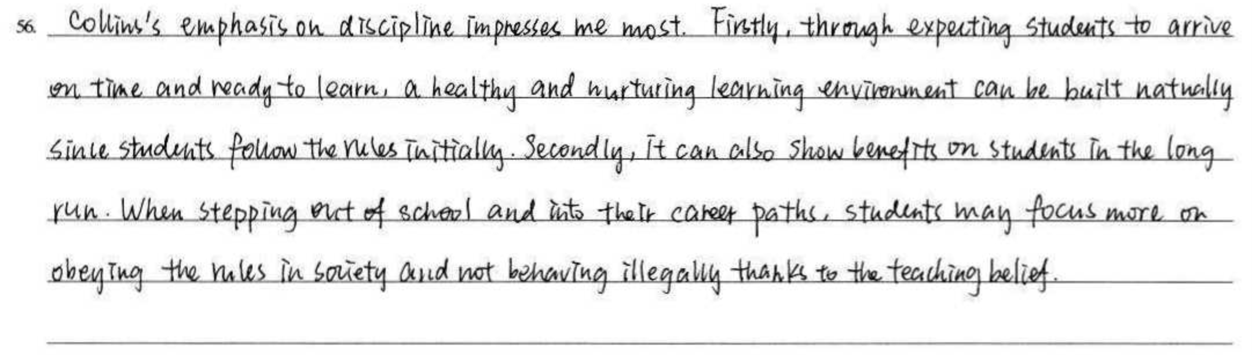

To comment or give an opinion
Which one of Collin’s teaching beliefs impresses you most? Why?
discipline
Learning environment
Better students
Obeying the rules
Better citizen

Slide 70
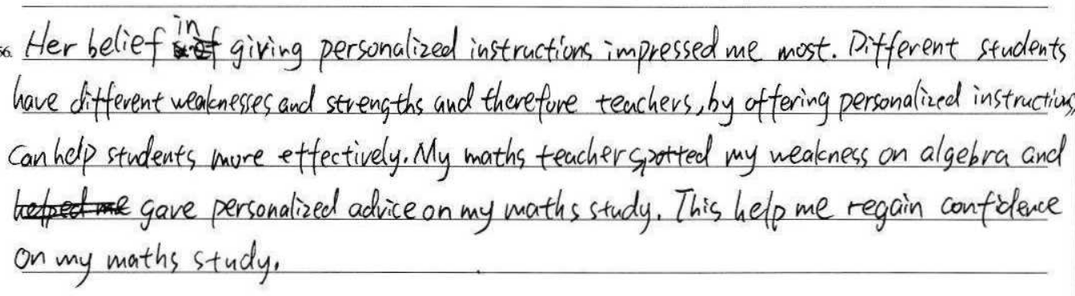
To comment or give an opinion
Which one of Collin’s teaching beliefs impresses you most? Why?
Personalized instruction
Learning efficiency
My own experience

Slide 71
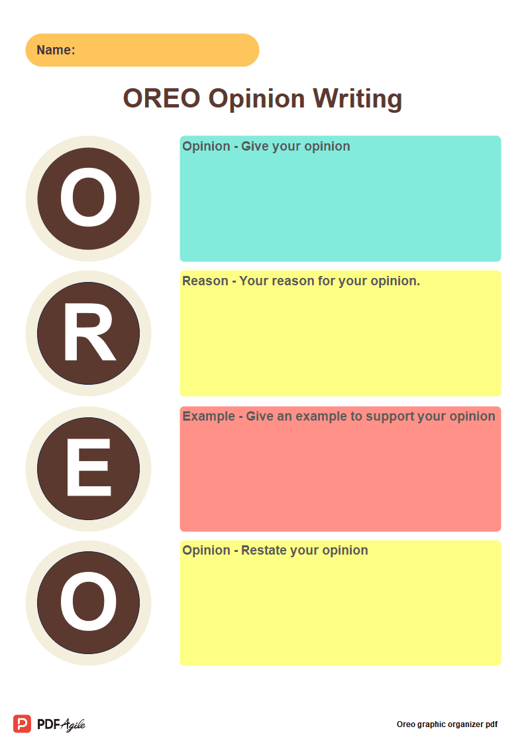
观点评价类
To comment or give an opinion
答题策略：Division-classification
Persuasive graphic organizer: OREO Chart
其他题目汇总：
What do you think of the behavior of pleasing others?
What's your comment about fashion industry?
Do you think virtual fitness classes will become a trend
for young people? Why or why not?
Please briefly present your opinion on digital inclusion.
Are you a follower of “ treat yourself culture”? why or why not?

Slide 72
Writing purpose - to inform
例证类
仔细审题，厘清概念，确保契合度。
行动方案类
大问题+小解决
Cause and effects (what does it mean? how does it help?)
Division-classification
Exemplification

Slide 73
Writing purpose - to comment or give an opinion
分析讨论类
答题策略： Division-classification
Avoid repetition and generalizition 避免同质化
观点评价类:
答题策略：Division-classification
Persuasive graphic organizer: OREO Chart

Slide 74
语法填空

Slide 75
答案
11. stretching 12. in 13. has expanded 14. innovative
15. are driven/have been driven 16. activities 17. where
18. whether/if /that 19. stressed 20. To avoid
注意事项
第18题可接受答案为三个whether/if /that ，后期试卷讲评会详细讲解。
所有题大小写错扣0.5分（得1分）。大小写形态上具有较高的相似性的字母不扣0.5，如S（s）、W（w）。
本次考试考察了多个易拼错单词，阅卷时仔细检查学生的拼写。
阅卷时如查看不到该题答案时，请提交异常卷。（组长可看整卷）

Slide 76
谢 谢！
本视频课程中的部分图片、视频引自有关图书、网络，特向这些图片、视频的制作者和有关图书的出版者和相关网络表示感谢；因多种原因，事先未与作者和出版社取得联系，特向他们表示歉意。

